Slide 1
Income Protection & Legacy Planning
Life Stages in a Circle
About this deck
In life, there are two major risks - Dying too soon and Living too long. The goal is to protect your parents, wife, children and yourself in the event of either risks. Take Action NOW!

Slide 2




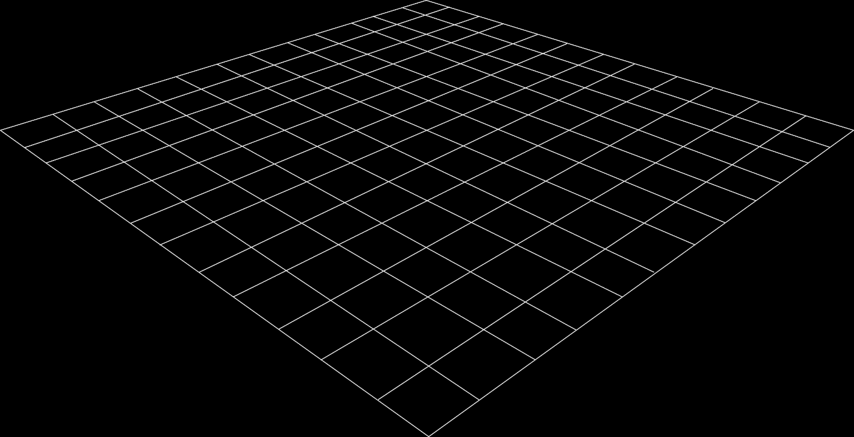




Financial Planning Thumb rule
Pay yourself first
How much to save
Food
Clothing
Rent
School Fees
Guaranteed instruments
Short/ medium term
Long term savings
Bank/ Govt Bonds/ Insurance
Entertainment
Luxurious lifestyle
2nd property and more
Investment in trading
Income minus Expenses = Savings
Create outflows for better control
Income minus Savings = Expenses
The 50-20-30 Rule

Slide 3
What is Your Lucky Number? Volunteers Please!
1
HOW MUCH SHOULD I BE SAVING FOR EMERGENCY?
Retire
80
0
Studying
Playing
Savings/ Fixed Deposits
2
HOW MUCH SHOULD I BUDGET FOR UNEXPECTED MEDICAL COST?
NO INCOME
Health Insurance
3
WHAT IF I CANNOT WORK UPTO 60?
60
20
Critical Illness OR ADDL Insurance
10 years passed
2nd Job
2nd Car
2nd House
Children
1st Job
1st Car
1st House
Married
Children
4
WHAT IF I DON’T REACH 60?
Life Insurance
30
5
HOW MUCH IS ENOUGH TO RETIRE?
Depends. Atleast 20% of Annual Income
40
CAN I ENSURE THAT MY CHILDREN START LIFE WITH THE RIGHT FOUNDATION?
-
=
6
40 years
10 years
30 years
Guaranteed Payout
10950 days

Slide 4
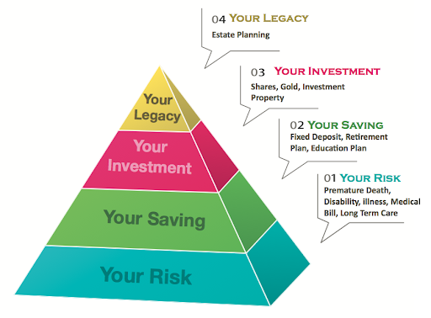
Needs Pyramid

Slide 5



Goal Setting
The single most important factor in a successful financial plan is your determination to take it seriously.
1
Realistic Financial Data Evaluate realistic base of data on your spending and saving habits, including expenses, income and large future expenditures.
2
Goals and Expectations Meet your goals – Child’s Schooling and Higher Education, Child’s marriage, Retirement, House, Medical Cost, Legacy Planning.
3
Age-Appropriate Investment Age is a factor in making a financial plan. The younger you are, the more years you have to accumulate money to meet your goals.

Slide 6
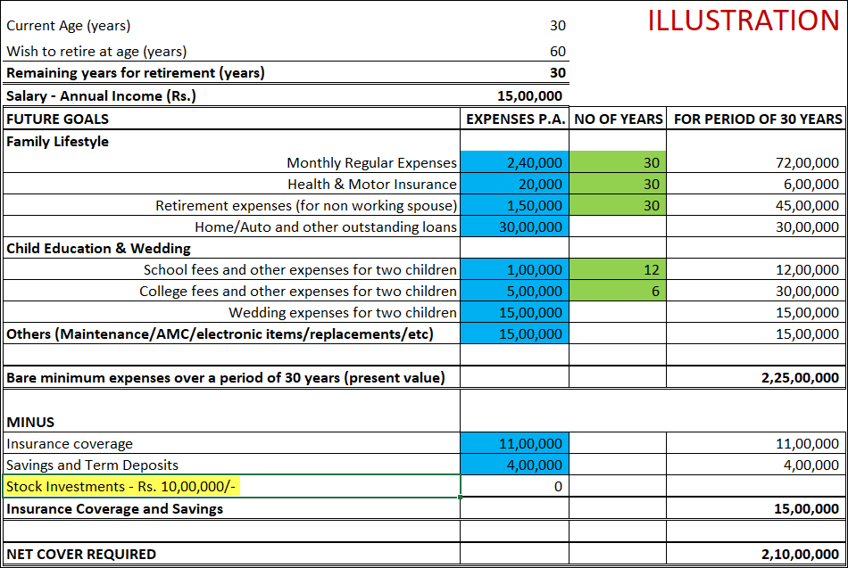
What is the Economic Value of Your Life?
The Economic value of an Individual Life (also known as Human Life Value) is a method of calculating the amount of life insurance a family would need based on the financial loss they would incur if the sole income earning person in the family were to pass away today.
A
B
C
D
E
F
H
G

Slide 7
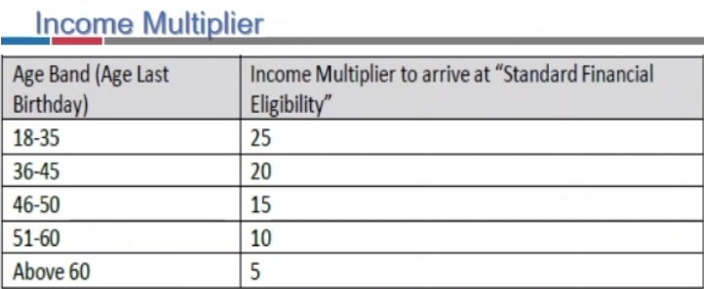
Illustration – Income Protection and Limited/Regular Pay Premium
Age (Years) | Income p.a. (Rs) | Sum Insured (Rs.) | Premium Limited Pay 12 Pay PPT (Rs.) | Premium Regular Pay (30yrs) (Rs.)
23 | 2 lakhs | 50 lakhs | Rs. 7847 * 12 yr = 94,164 | Rs. 6667 * 30 yr =200,010
 | 12 lakhs | 3 crores | Rs. 36816 *12 yr = 441,792 | Rs. 32922 * 30 yr = 987,660
 | 20 lakhs | 5 crores | Rs. 59000 *12 yr = 708,000 | Rs. 54870 * 30 yr = 1,646,100
35 | 2 lakhs | 50 lakhs | Rs. 13216 *12 yr = 158,592 | Rs. 9322 * 30 yr = 279,660
 | 12 lakhs | 3 crores | Rs. 66198 *12 yr = 794,376 | Rs. 48852 * 30 yr = 1,465,560
 | 20 lakhs | 5 crores | Rs 108560 *12 yr = 1,302,720 | Rs. 81420 * 30 yr = 2,442,600
45 | 2 lakhs | 40 lakhs | *Not eligible | *Not eligible
 | 12 lakhs | 2.4 crores | Rs 112997 *12 yr = 1,355,964 | Rs. 86376 * 30 yr = 2,591,280
 | 20 lakhs | 4 crores | Rs 185968 *12 yr = 2,231,616 | Rs 143960 * 30 yr = 4,318,800

Slide 8
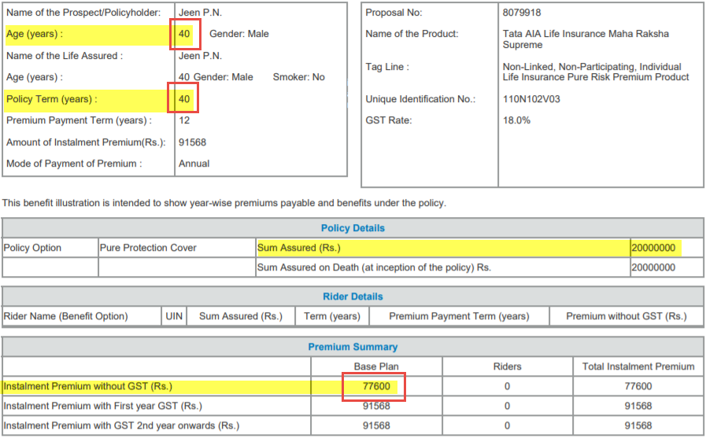
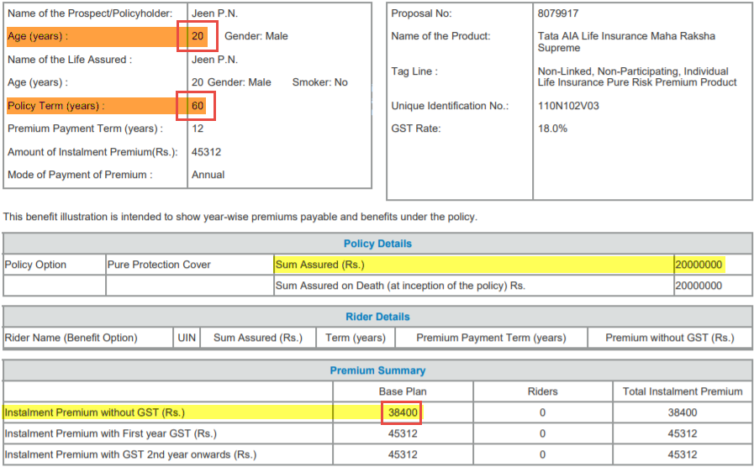
Illustration – Facts to Know About Insurance Before It Is Too Late!
COST TILL AGE 80 YEARS
YOU WILL NOT GET TERM INSURANCE
IF YOU HAVE CRITICAL ILLNESS
Or
IF YOU DO NOT EARN INCOME
Or
IF YOU ARE NOT WITHIN AGE LIMIT

Slide 9
Financial Planning $≠$ Get-Rich-Quick-Strategy
Financial planning has a causal effect on mental peace
Notes:
Aagama # ritual text

Slide 10
#Disappointment #Decision #Anxiety
Money is one of the most important subjects of your entire life. Some of life's greatest enjoyments and most of life's greatest disappointments stem from your decisions about money. Whether you experience great peace of mind or constant anxiety will depend on getting your finances under control.
- Robert G Allen (Author, Speaker, Mentor)

Slide 11
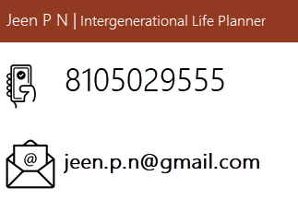

More questions about Financial Life Planning?
Want to Seek more information on:
Risk Mitigation
Long Term Savings
Legacy Planning

